Slide 1

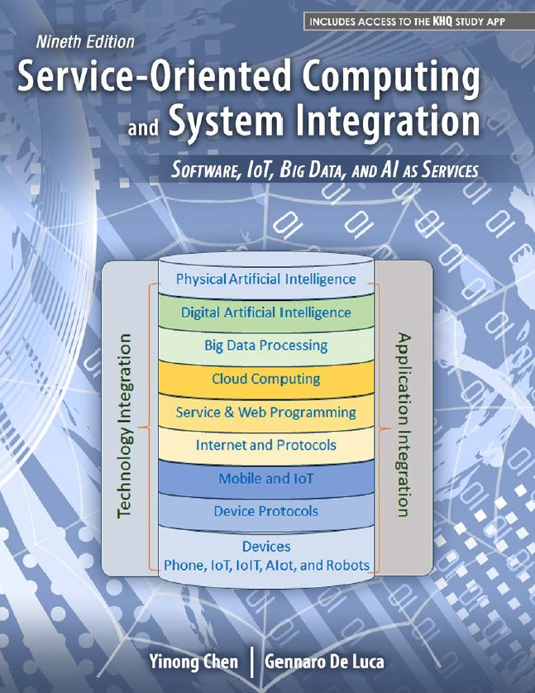
CSE 445/598 Distributed Software Development Day One Itinerary
Dr. Yinong Chen
Spring 2024
Notes:
Zoom Key – P#J3+!EM

Slide 2
Day One Itinerary
Instructor: Yinong Chen
Course objectives & outcomes
Course Coverage
Activities, Weights and Grade
Course Policies
Starting Chapter 1
Computer Architecture
Software Architecture
Distributed Software Architectures

Slide 3
Instructor: Yinong Chen
Joined ASU CSE in 2001
This Fall:
CSE445/598 Distributed Software Development
CSE446/598 Software Integration and Engineering
FSE598 Emerging Computing Technologies
Before this semester at ASU
ASU 101, F11, F19 CSE 101/FSE100: Every semester from Fall 06 to Fall 11, S16
CSE 230: F11, F12, S13, F13, F14
CSE 220: S2017, S2017, S2018, S2019
CSE 240: Every semester since F2001
CSE 310: SS01, F01, SS02
CSE 225/EEE225: F02, S03, F03, S04; CSE 330: S02, SS 03 → CSE230 CSE 420/598: S01
CSE 423: (Capstone) S08, F09; CSE485 F15
CSE 445/598: Almost every Fall and summer since 2006 CSE 446/598: Every Spring and Summer since 2010.
CSE 551 Foundations of Algorithms, Spring 2021, Spring 2023
CSE 565 Software Verification, Validation, and Testing, F20, F22
CSE 598 Foundations of Social Media Mining, Spring 2022
FSE598 Emerging Computing Technologies, Fall 22, Spring 2023, summer 2023, Spring 2024

Slide 4

Yinong Chen, Principal Lecturer
Before joining ASU
Taught for six years Department of Computer Science Wits University of Johannesburg, South Africa
Postdoc at LAAS-CNRS, Toulouse, France
Ph.D. from Karlsruhe Institute of Technology (KIT), one of the best universities in Germany
Contact and more … http://www.public.asu.edu/~ychen10/
Heinrich Hertz worked at KIT from 1885 to 1888, where he discovered electromagnetic waves

Slide 5
Yinong Chen: Academic Work
More than 10 books
More than 300 research papers, most are in robotics, service-oriented computing, and computer science education
Editor in Chief, Associate Editor, Editorial Board Member of international journals
Chair of international conferences
Keynote, panel talks
Teach high school students to program robots

Slide 6

The Current CSE 445/598 since 2006
Title
CSE 445/598 Distributed Software Development
Catalog Description
Distributed system architectures and design, service-oriented computing, and frameworks for development of distributed applications and software components
Course Syllabus
Course website in Canvas
Textbook Approved in Spring 2008
The book (9th Ed.) 2024 will be heavily used. The 8th Edition is OK if you have it.
2014

Slide 7
ASU is a Leader in SOA Education
The current SOA-based CSE445 title and contents started in Fall 2006. The change was initiated and approved by:
CS Software Engineering Concentration Committee
CS Undergraduate Program Committee (UPC)
CS Faculty Assembly
Developing a new course is a serious issue, needs the commitment from the school, and requires significant efforts from many faculty members.
ASU is playing a leading role in SOA education, from high school to graduate school
CSE446: Software Integration & Engineering, Spring 2012 The course will use Part II of the same text
Offered in every spring
Prerequisite: CSE445!

Slide 8
Course Objectives and Outcomes
1. To develop an understanding of the software engineering of programs using concurrency and synchronization
Students can identify the application, advantages and disadvantages of concurrency, threads and synchronization.
Students can apply design principles for concurrency and synchronization.
Students can design and write programs demonstrating the use of concurrency, threads and synchronization.

Slide 9
Objectives and Outcomes
2. To develop an understanding of the development of distributed software
Students can recognize alternative distributed computing paradigms and technologies.
Students can identify the phases and deliverables of the software lifecycle in the development of distributed software.
Students can create the required deliverables in the development of distributed software in each phase of a software lifecycle.
Students understand the security and reliability attributes of distributed applications

Slide 10
Objectives and Outcomes
3. To develop an ability to design and publish services as building blocks of service-oriented applications
Students understand the role of service publication and service directories
Students can identify available services in service registries.
Students can design services in a programming language and publish services for the public to use.

Slide 11
Objectives and Outcomes
4. To build skills in using a current technology for developing distributed systems and applications
Students can develop distributed programs using the current technology and standards.
Students can use the current framework to develop programs and web applications using graphical user interfaces, remote services, and workflow.

Slide 12
Weight and Grading Scale
Quizzes and chapter tests will be given online for all students. You can take them after the lectures.
Percentage | Symbol Grade
96.5-100% 92.5-96.4% 89.5-92.4% | A+ A A-
86.5-89.4% 82.5-86.4% 79.5-82.4% | B+ B B-
75.5-79.4% 69.5-75.4% | C+ C
59.5-69.4% | D
Below 60% | E
Graded Activity | Weight
Assignments* | 30%
Quizzes** | 11%
Chapter Tests 1, 2, 3, 4, 5* | 12%
Mid-Term Exam | 22%
Final Exam | 25%
* The lowest one will be dropped, no make up. However, the last project (two assignments) is important and will not be dropped.
** The lowest two will be dropped, to cover all possible situations:
computer/network problem, minor illness, emergency situations, etc. No re-take or reset for any reason.

Slide 13
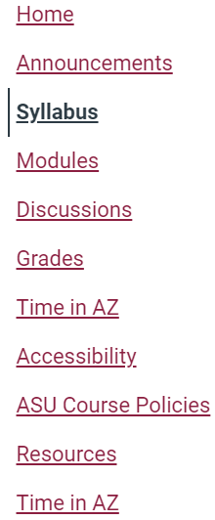
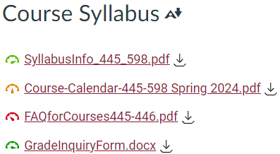
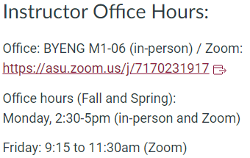
CSE445/598 in ASU Canvas

Slide 14
Calendar File (PDF)
Quiz 0 Practice quiz
From Quiz 1 required quiz
Required Module/ Chapter Test

Slide 15
Calendar File (PDF)
In-Person class
Exam in classroom

Slide 16
Calendar File (PDF)
In-Person Class Final
Exam in classroom

Slide 17
FAQ Document: For examples:
Quiz will test this lecture and this document contents.
Q: If my internet connection breaks or my computer freezes in the middle of writing an online test, can the instructor reset the test, so that I can retake the test?
A: The following policy will be strictly applied to cover all possible situations, including sickness, emergency, and computer problems:
Two lowest quiz scores and one chapter test score will be dropped automatically.
No exception will be given to anyone. Do not ask for an exception.
Q: I submitted a wrong assignment file. I can show you on my Dropbox that I completed the assignment before the due date. Can my assignment be graded?
A: No. To be fair to everyone, no exception will be given. We drop the lowest assignment score (except the last assignment).
Q: I completed this assignment. Could you please check if I did right?
A: The instructor and TA cannot pre-grade your assignment. We do not have the capacity to do so for all students. It is not fair if we do this for one but not for everyone. Please check your answer against the description / requirement. You can ask questions if you think the description / requirement is not clear.

Slide 18
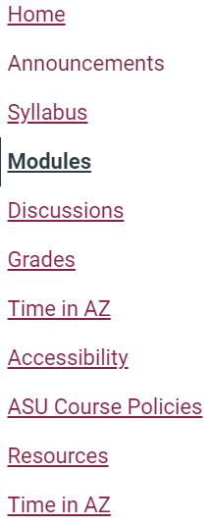
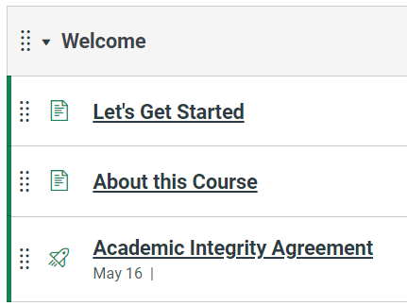
CSE445/598 in ASU Canvas

Slide 19
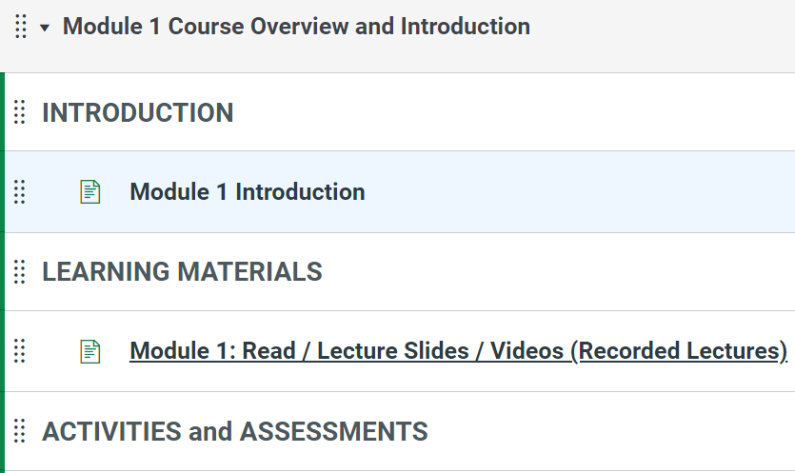
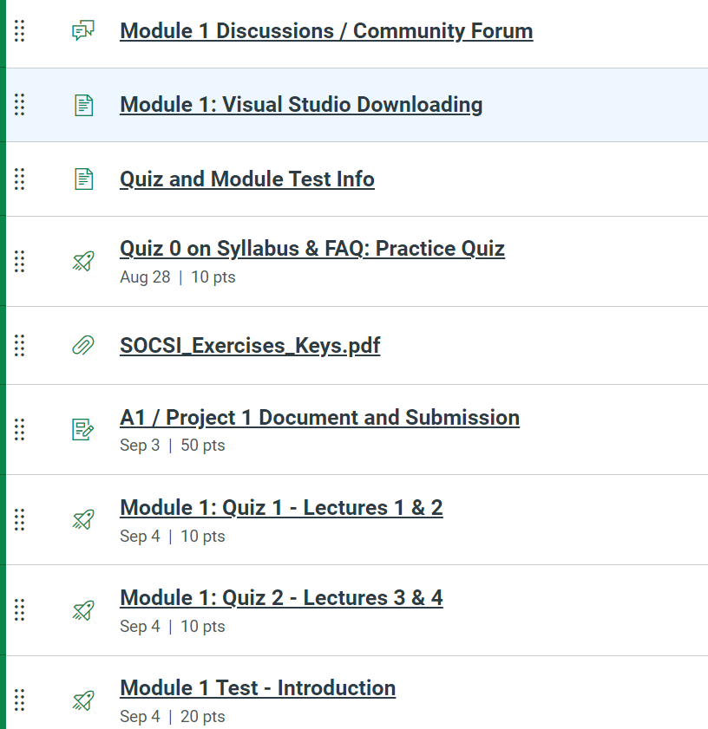
CSE445/598 in ASU Canvas

Slide 20
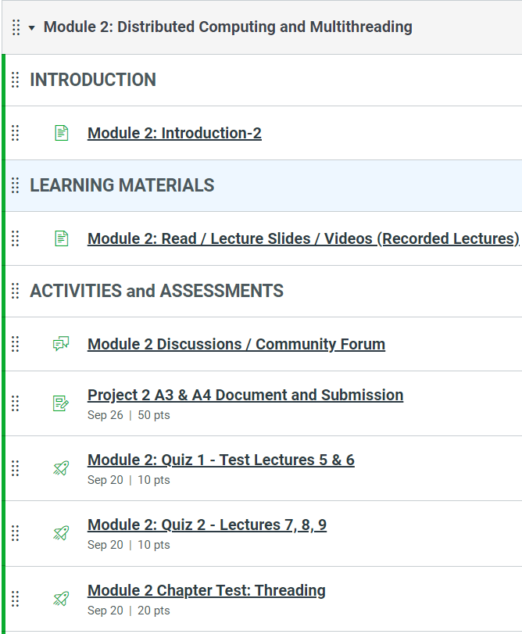
CSE445/598 in ASU Canvas

Slide 21
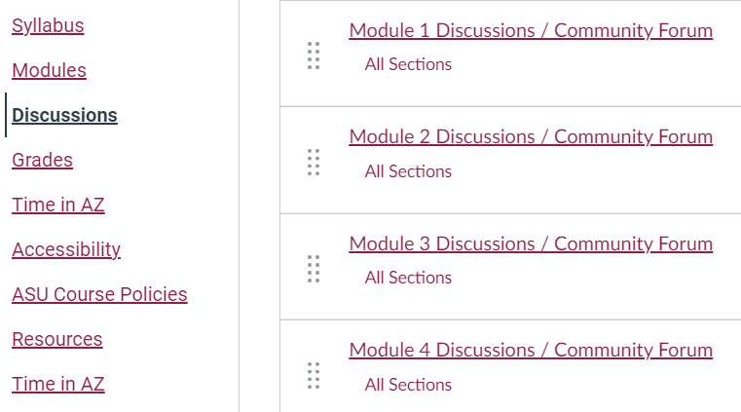
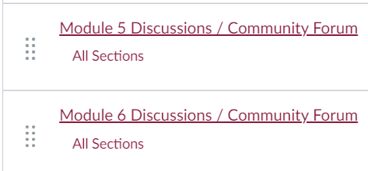
CSE445/598 in ASU Canvas

Slide 22
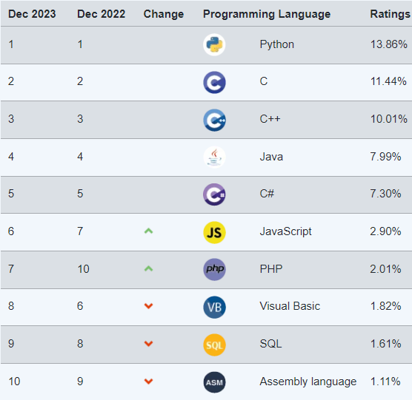
TIOBE Index for August 2023
http://www.tiobe.com/tiobe-index/

Slide 23
Standard Classroom Expectation (Not applicable for online section)
Mute your mic and silent your cellular phone; If your phone happens to ring, stop it immediately and do not answer your phone!
Use computer for directly related activities only, e.g., taking notes. No computer is allowed during any tests (lecture exercises quizzes, exams).
Do not talk to each other while the instructor is talking. If you have a question that needs to be resolved immediately, ask the instructor.
Enter the classroom before the lecture’s starting time.
Do not leave the classroom during the lecture, unless there is an emergency situation.

Slide 24
Policies
Interaction: You are encouraged to ask the instructor questions during the lectures.
Outside class help welcome and encouraged:
Discussion board (effective and fair);
Instructor’s and the TA’s office hours (not in summer sessions)
Emails – Use Canvas mail, so that I can process them timely.
Request appointments if you can not make the office hours;
Tests and exams: Missing tests and exams will be giving zero credit and may not be made up.
Assignments: Late submission will be accepted with grade deduction: 1% (2% in summer session) of grade deduction for every hour after the due time.

Slide 25
Extra credit, alternative, and inquires
No extra credit-activities will be given to any individual. Extra credit-activities may be given to the entire class.
An alternative to a graded activity may be arranged if a student's absence is caused by documented illness or documented personal emergency. A written explanation (including supporting documentation) must be submitted to the instructor before the part of work is due or as soon as the circumstances are known.
Any inquires or appeals on grades of homework, projects, or tests must be done in writing by completing the "Grade Inquiry Form" within a week from the day the grades and/or comments were published on-line. State the problem and the rationale for any change in grade in your appeal

Slide 26
Academic Integrity (AI) and Code of Conduct
You are encouraged to cooperate in study group on learning course materials.
You may not cooperate on preparing the individual assignments. Anything you turn in must be your own work. If you use an idea that is found in a book or other sources, make sure you acknowledge the source and/or the names of the persons in the write-up for each problem.
All assignment questions must be asked in the course discussion board. Asking assignment questions or making your assignment available in the public websites before the assignment due will be considered AI policy violation.
The instructor and the TA are required to CAREFULLY check any possible proliferation or plagiarism. We will use the software tools like MOSS (Measure Of Software Similarity) to check any assignment. The university expects all students to adhere to ASU's policy on Academic Dishonesty. These policies can be found in the Code of Student Conduct:
https://provost.asu.edu/academicintegrity/policy
ALL cases of AI policy violation will be handed to the Dean's office. Penalties include a failing grade in the class, a note on your official transcript (XE) that shows you were punished for AI policy violation .

Slide 27
Academic Dishonesty includes
https://provost.asu.edu/academicintegrity/policy
a. Academic Deceit;
b. Referring to unauthorized materials, sources, or devices …;
c. Possessing, reviewing, buying, selling, posting …
d. Using a substitute or acting as a substitute …;
e. Relying on the aid of others,…;
f. Providing inappropriate aid to another person …,
g. Plagiarism, … .
h. Claiming credit for or submitting work done by another …;
i. Signing an attendance sheet for another student, … ;
j. Falsifying or misrepresenting hours or activities
k. Attempting to influence or change any Academic Evaluation, or academic record for reasons having no relevance to academic achievement.
Dear instructor, I missed 1 point to receive a B grade. This is important to me and to my family. If I do not receive a B in this course, I will lose my scholarship, and I have to drop from the university. → Dishonest and unethical request!

Slide 28

CSE 445/598
Distributed Software Development
Chapter 1
Introduction to Distributed
Software Development
(Read Textbook Chapter 1)

